Slide 1


GIT Assignment
Presented By : Ronak Janawa

Slide 2
Agenda
Introduction
Learn About Git and its Commands.
Our Tasks
Completion of the Tasks.
My Work
My work on Git and all its functionality.
Fetch Command
This is about how we can use fetch.

Slide 3
Git Introduction
Git is software for tracking changes in any set of files, usually used for coordinating work among programmers collaboratively developing source code during software development. Its goals include speed, data integrity, and support for distributed, non-linear workflows.
VCS
Three Stages
Repository
Version Control System allows you to manage changes to the files over time and store these modifications in a database
To inform about the three stages of Git which are Working Directory, Staging area, Git Directory(Repository).
Repository is a storage location for software packages.

Slide 4
Our Tasks
Create and collaborate on a new empty repository on GitHub.
Each member should make one commit each.
Group needs to learn and discuss on the following topic - fetch
We need to push the slides or the doc you create to this repository.

Slide 5
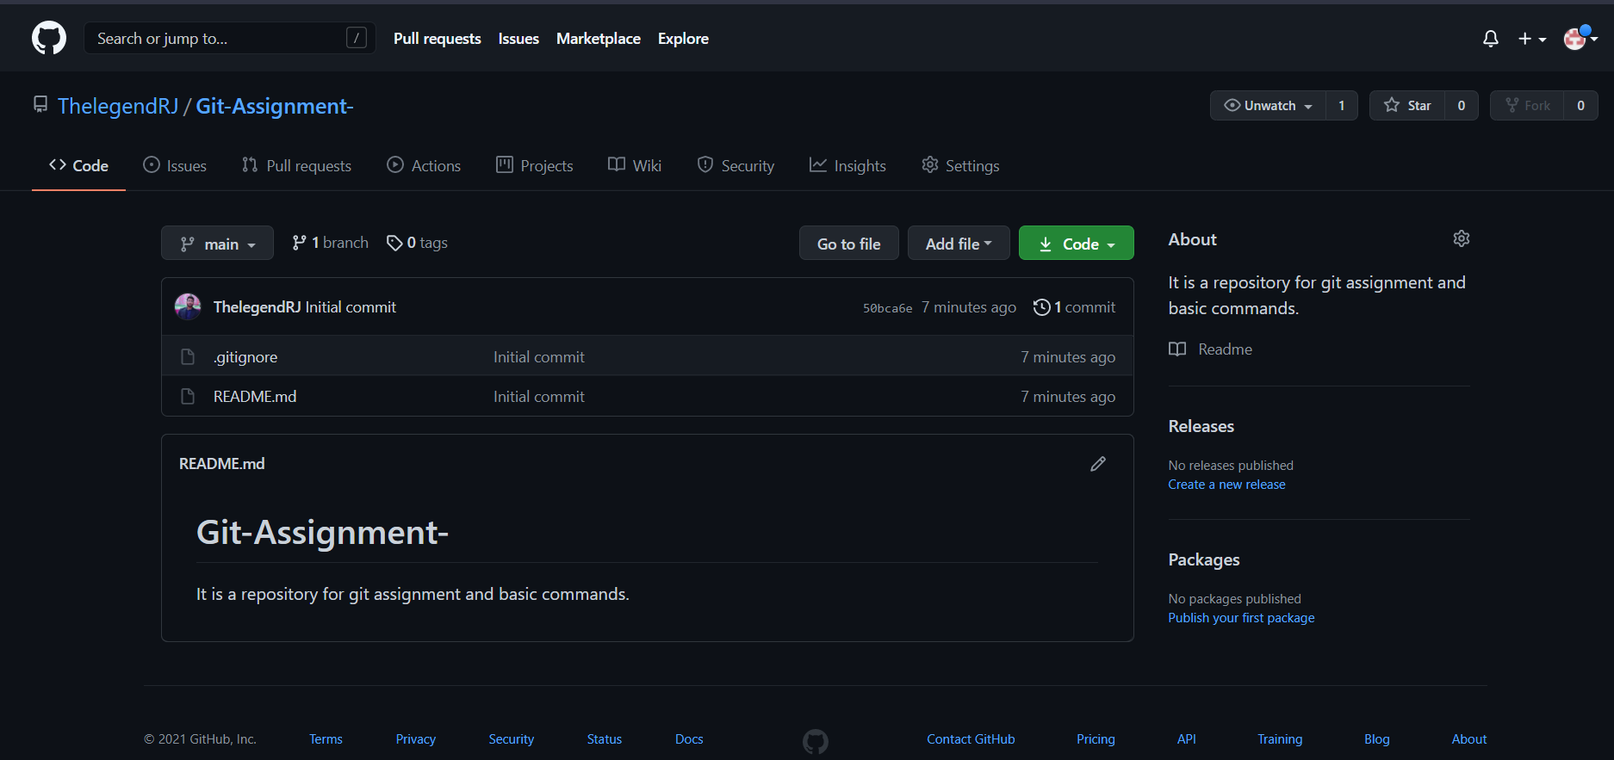
Task 1
Create and collaborate on a new empty repository on GitHub.

Slide 6
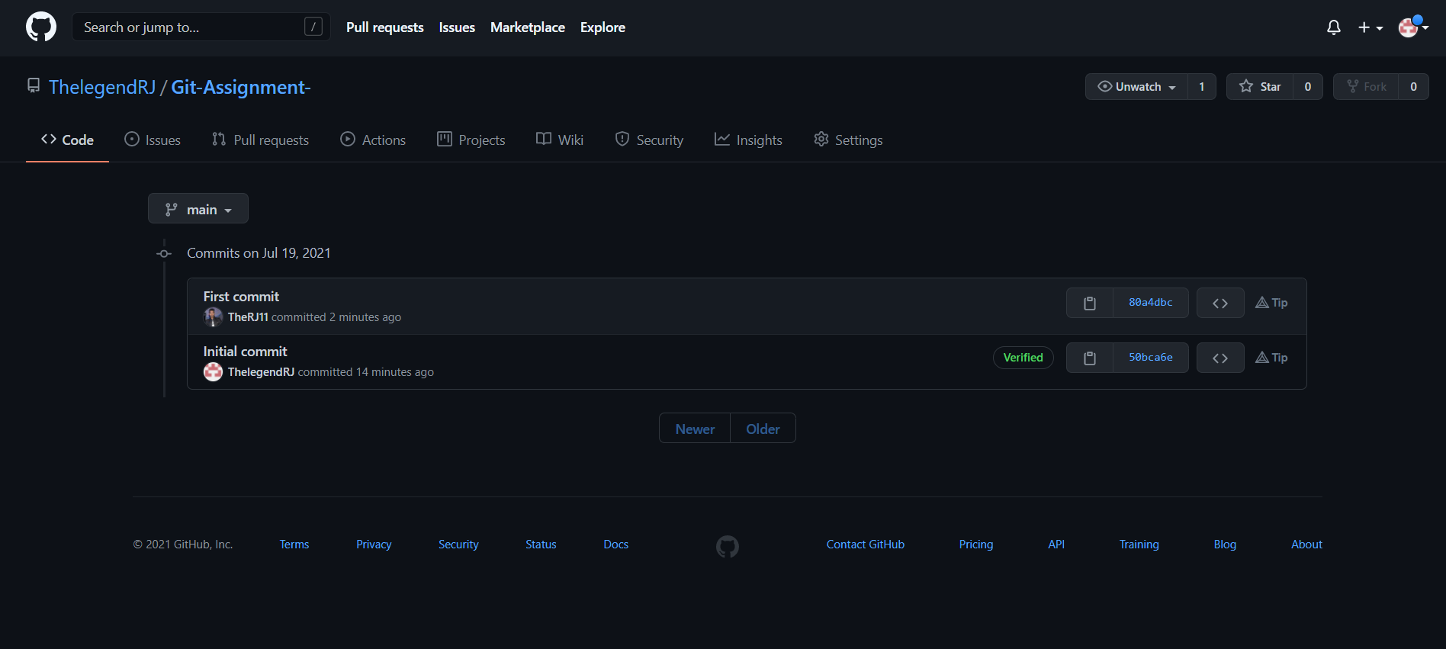
Task 2
Each member should make one commit each.

Slide 7

Fetch
The git fetch command downloads commits, files, and refs from a remote repository into your local repo.
Fetching is what you do when you want to see what everybody else has been working on.
Git isolates fetched content from existing local content; it has absolutely no effect on your local development work
This makes fetching a safe way to review commits before integrating them with your local repository.
Task 3
learn and discuss on the following topic - fetch

Slide 8
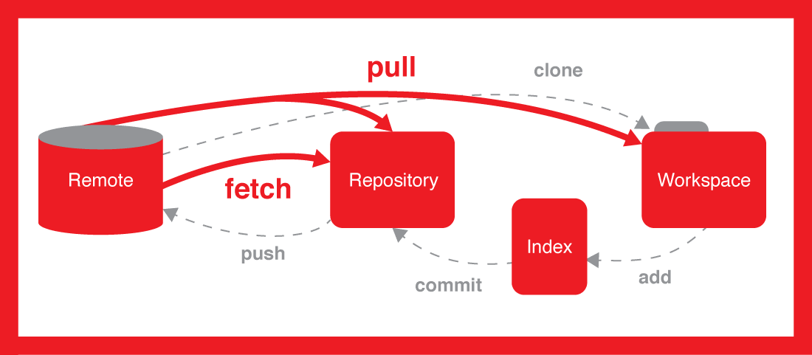
Fetch Command

Slide 9
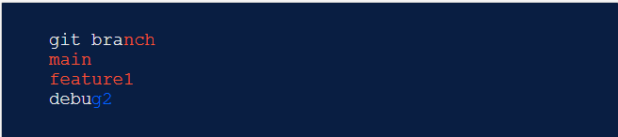
How git fetch works with remote branches
Behind the scenes, in the repository's ./.git/objects directory, Git stores all commits, local and remote.
Git keeps remote and local branch commits distinctly separate through the use of branch refs. The refs for local branches are stored in the ./.git/refs/heads/.
Executing the git branch command will output a list of the local branch refs.
The following is an example of git branch output with some demo branch names.

Slide 10
How git fetch works with remote branches
Remote branches are just like local branches, except they map to commits from somebody else’s repository.
Remote branches are prefixed by the remote they belong to so that you don’t mix them up with local branches. Like local branches, Git also has refs for remote branches.
We can inspect remote branches with the usual git checkout and git log commands.
If you approve the changes a remote branch contains, you can merge it into a local branch with a normal git merge.

Slide 11


Git fetch commands
Fetch all of the branches from the repository. This also downloads all of the required commits and files from the other repository.
Same as the above command, but only fetch the specified branch.

Slide 12


Git fetch commands
A power move which fetches all registered remotes and their branches
The --dry-run option will perform a demo run of the command. It will output examples of actions it will take during the fetch but not apply them.

Slide 13
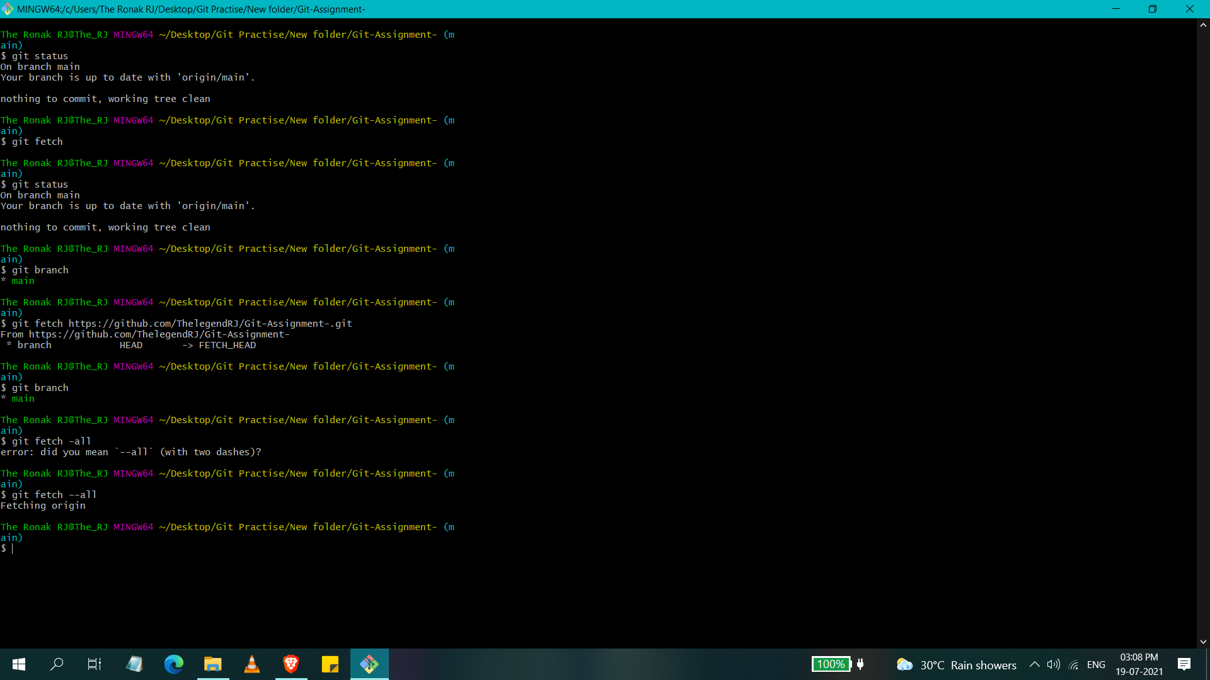
My Work On Fetch

Slide 14
Conclusion Fetch
The git fetch command is used to download the contents from a remote repository. Developers use the git fetch command and the git checkout command to work with code on a different branch.
The git fetch command is similar to git pull. git pull directly changes your local working copy of a repository. The git fetch command, on the other hand, only retrieves the metadata associated with a remote repository.

Slide 15
References
https://careerkarma.com/blog/git-fetch/
https://www.atlassian.com/git/tutorials/syncing/git-fetch#:~:text=The%20git%20fetch%20command%20downloads,else%20has%20been%20working%20on.&text=This%20makes%20fetching%20a%20safe,them%20with%20your%20local%20repository.
https://git-scm.com/docs/git-fetch

Slide 16

Thank You!

